Slide 1
Web Programming
Lecture 4
Bootstrap + CSS Positioning
Mahhek Tahir
Notes:
.

Slide 2
Responsive Design.
Grid System (Bootstrap, tailwind)
CSS Media Queries

Slide 3
Media Queries
What are Media Queries?
CSS rules that apply styles based on device characteristics such as screen width, height, or orientation.
Common Use Cases:
Adjusting layouts for different screen sizes.
Changing font sizes on smaller screens.
Hiding or showing elements.

Slide 4
@media (max-width: 600px) {
body {
background-color: lightblue;
}
}
@media (min-width: 601px) and (max-width: 900px) {
body {
background-color: purple;
}
}
@media (orientation: portrait) {
img {
width: 100%;
}
}

Slide 5
/* Extra small devices (phones, 600px and down) */
@media only screen and (max-width: 600px) {...}
/* Small devices (portrait tablets and large phones, 600px and up) */
@media only screen and (min-width: 600px) {...}
/* Medium devices (landscape tablets, 768px and up) */
@media only screen and (min-width: 768px) {...}
/* Large devices (laptops/desktops, 992px and up) */
@media only screen and (min-width: 992px) {...}
/* Extra large devices (large laptops and desktops, 1200px and up) */
@media only screen and (min-width: 1200px) {...}

Slide 6
What is Flex?
Definition: Flexbox, or the Flexible Box Layout, is a CSS module that provides a way to arrange items in a container.
Key Features:
Align items horizontally or vertically.
Control the spacing between items.
Handle dynamic resizing of elements within a container.

Slide 7
CSS Layout – Position
The position is CSS sets how an element is positioned in a document.
Static: Default positioning; elements are placed in the normal flow.
Relative: Positioned relative to its normal position.
Absolute: Positioned relative to the nearest positioned ancestor.
Fixed: Positioned relative to the viewport; does not move on scroll.
Sticky: Switches between relative and fixed based on scroll position.

Slide 8
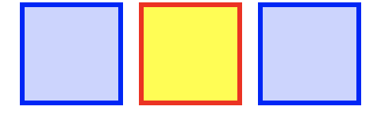
Static
The element is positioned according to the Normal Flow of the document. The top, right, bottom, left, and z-index properties have no effect. This is the default value.

Slide 9
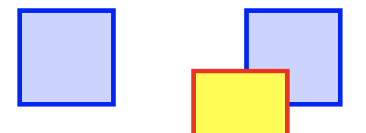
Relative
The element is positioned according to the normal flow of the document, and then offset relative to itself based on the values of top, right, bottom, and left. The offset does not affect the position of any other elements; thus, the space given for the element in the page layout is the same as if position were static.
position: relative;
top: 40px; left: 40px;

Slide 10
Fixed & Sticky
position: fixed: The element is removed from the normal document flow. Its final position is determined by the values of top, right, bottom, and left. For instance a website with a header and navigation that always stays visible when you are scrolling is a good example of fixed positioning.
position: sticky basically acts like position: relative until an element is scrolled beyond a specific offset, in which case it turns into position: fixed,

Slide 11
What is bootstrap?
Bootstrap is a powerful, open-source front-end framework used for designing responsive and mobile-first websites.
Why use bootstrap?
Speeds up development.
Pre-styled components.
Easy to create responsive designs.

Slide 12
Key Features of Bootstrap
Responsive Grid System
Pre-designed Components
Buttons, Modals, Alerts, etc.
Customizable
Built with Sass and a theming system.
Cross-Browser Compatibility
Extensive Documentation

Slide 13
Bootstrap 5
<!-- Bootstrap CSS --> <link
href="https://cdn.jsdelivr.net/npm/bootstrap@5.0.2/dist/css/
bootstrap.min.css" rel="stylesheet"
integrity="sha384-EVSTQN3/azprG1Anm3QDgpJLIm9Nao0Yz1ztcQTwFs
pd3yD65VohhpuuCOmLASjC" crossorigin="anonymous">
<!-- Bootstrap JS Bundle with Popper --> <script
src="https://cdn.jsdelivr.net/npm/bootstrap@5.0.2/dist/js/bo
otstrap.bundle.min.js"
integrity="sha384-MrcW6ZMFYlzcLA8Nl+NtUVF0sA7MsXsP1UyJoMp4YL
EuNSfAP+JcXn/tWtIaxVXM" crossorigin="anonymous"></script>

Slide 14

Bootstrap Container
Containers are used to pad the content inside of them, and there are two container classes available:
The .container class provides a responsive fixed width container
The .container-fluid class provides a full width container, spanning the entire width of the viewport

Slide 15
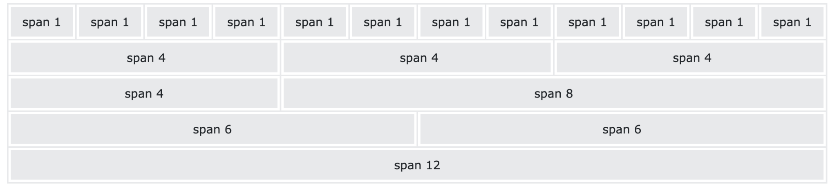
Bootstrap Grid System
What is the Grid System?
Divides the page into a 12-column layout.
Core Concepts:
Containers (fixed and fluid).
Rows and Columns.
Breakpoints for responsiveness.

Slide 16
<div class="container">
<div class="row">
<div class="col-md-6"></div>
<div class="col-md-6"></div>
</div>
<div class="row">
<div class="col-md-4"></div>
<div class="col-md-4"></div>
<div class="col-md-4"></div>
</div>
</div>

Slide 17
Typography and Components
Typography
Predefined styles for headings, paragraphs, and text utilities.
Common Components:
Buttons
Alerts
Navigation Bars
Modals
Example:
<button class="btn btn-primary">Click Me!</button>

Slide 18
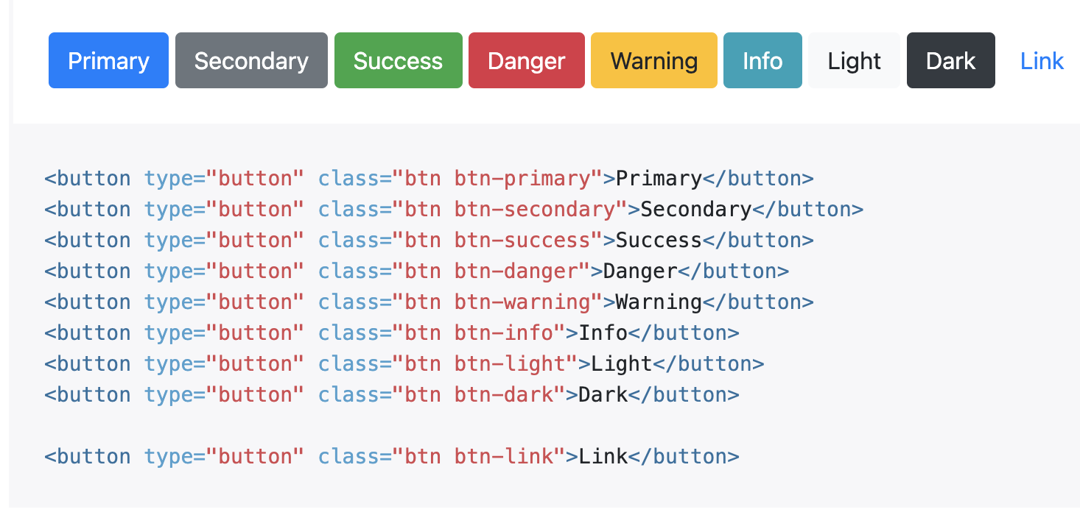
Bootstrap Buttons

Slide 19
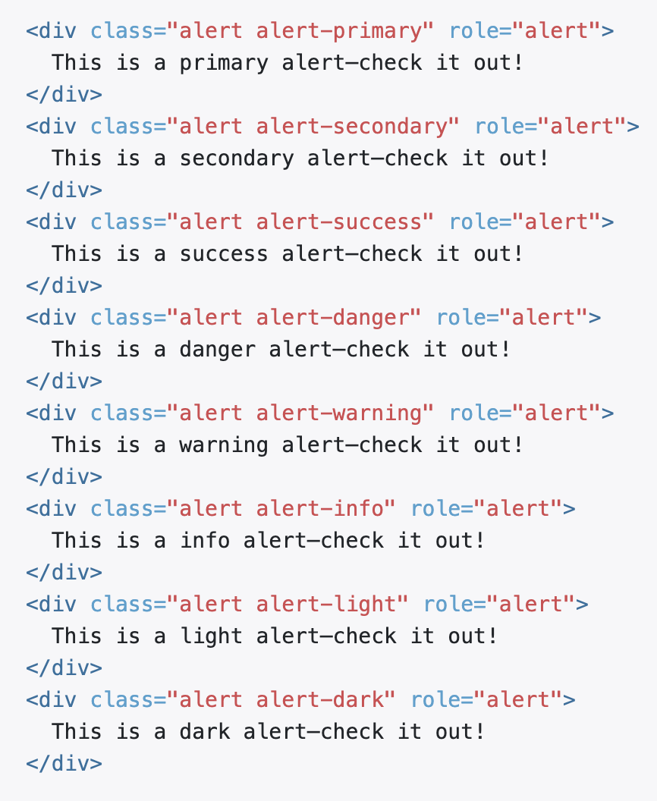
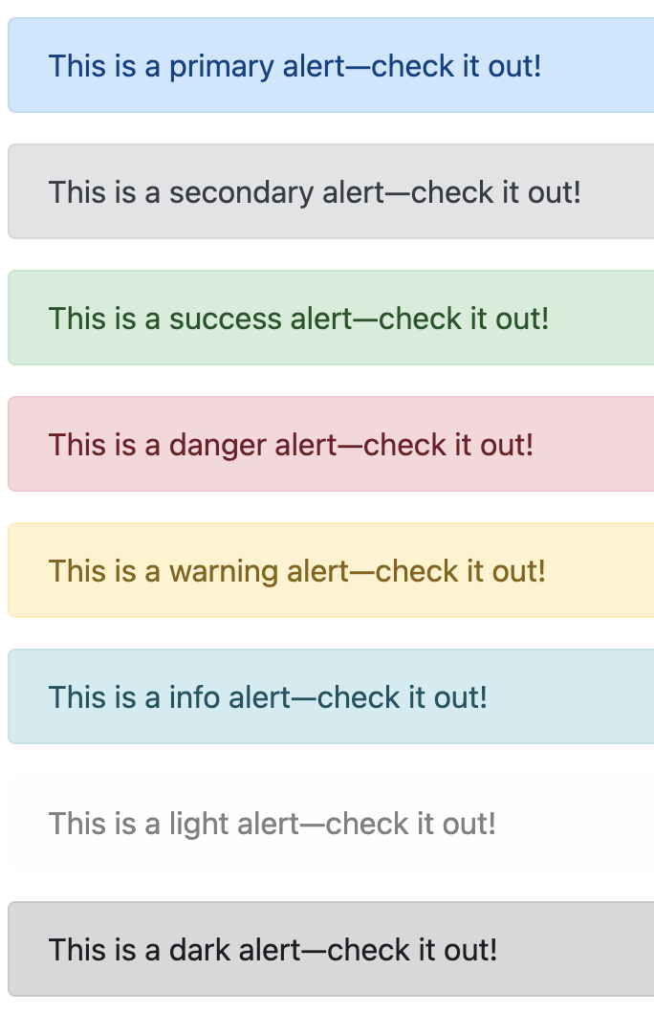
Bootstrap Alerts

Slide 20
The classes for text colors are: .text-muted, .text-primary, .text-success, .text-info, .text-warning, .text-danger, .text-secondary, .text-white, .text-dark, .text-body
The classes for background colors are: .bg-primary, .bg-success, .bg-info, .bg-warning, .bg-danger, .bg-secondary, .bg-dark and .bg-ligh
The .table class adds basic styling to a table:
The .table-striped class adds zebra-stripes to a table:
The .table-bordered class adds borders on all sides of the table and cells:
The .table-hover class adds a hover effect (grey background color) on table rows
The .rounded class adds rounded corners to an image:
The .rounded-circle class shapes the image to a circle:
The .img-thumbnail class shapes the image to a thumbnail (bordered):

Slide 21
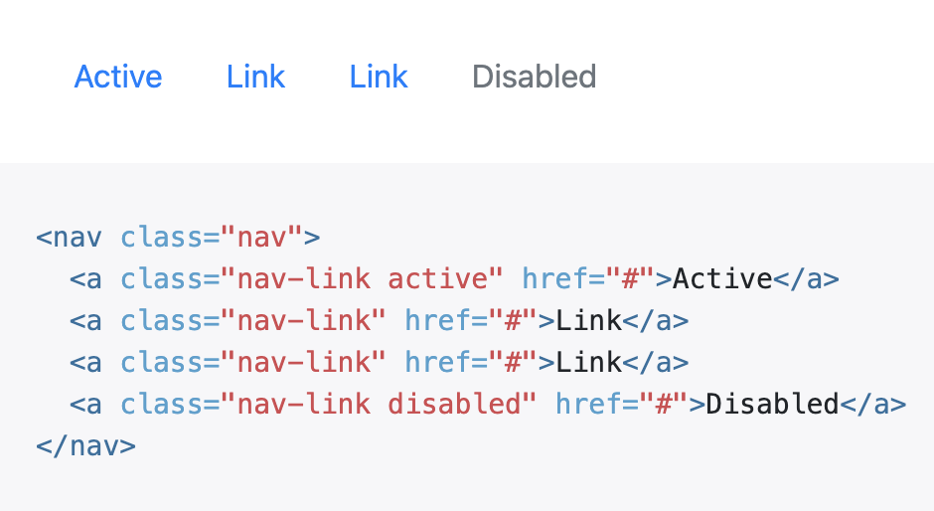
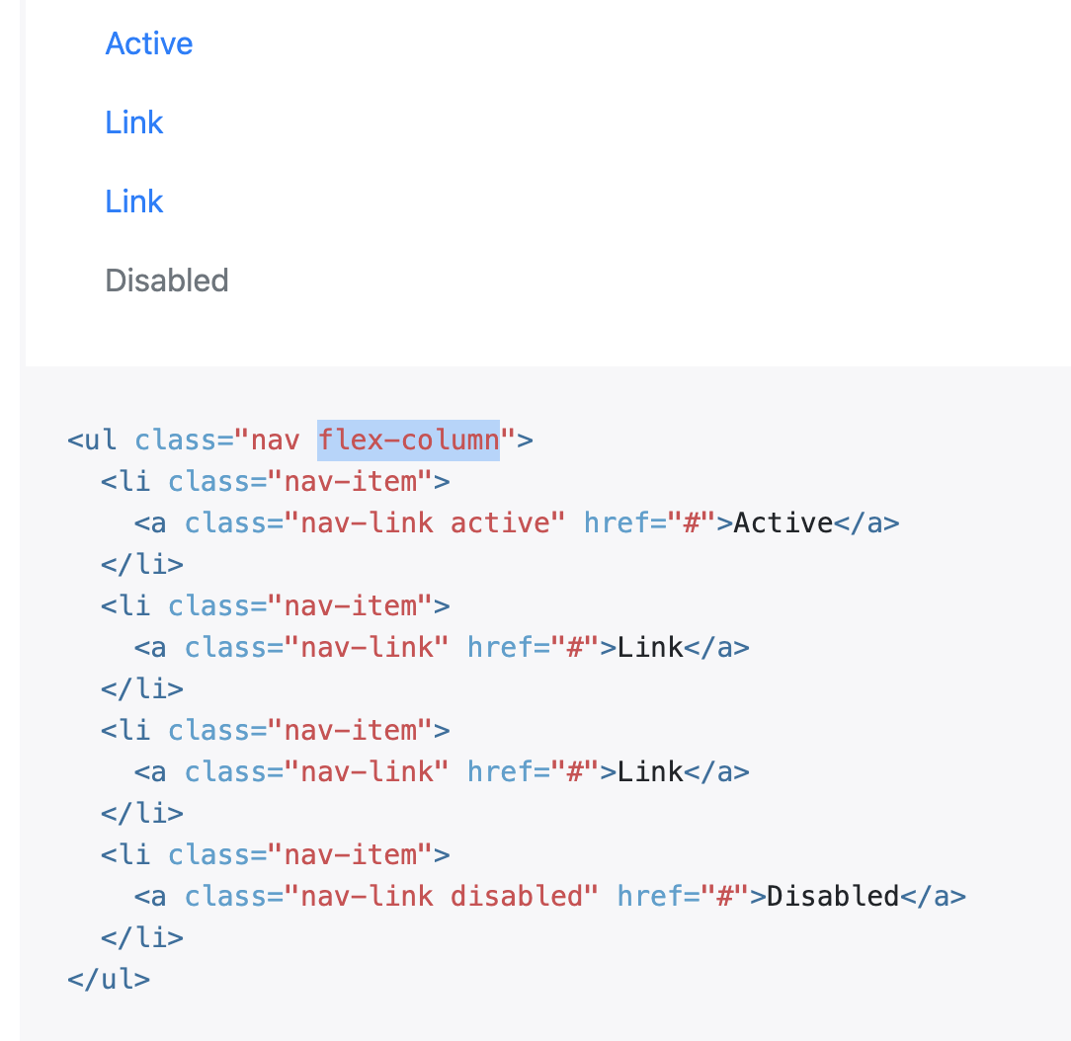
Bootstrap Navigation Bar
.nav uses display: flex
flex-column class on nav makes it vertical

Slide 22
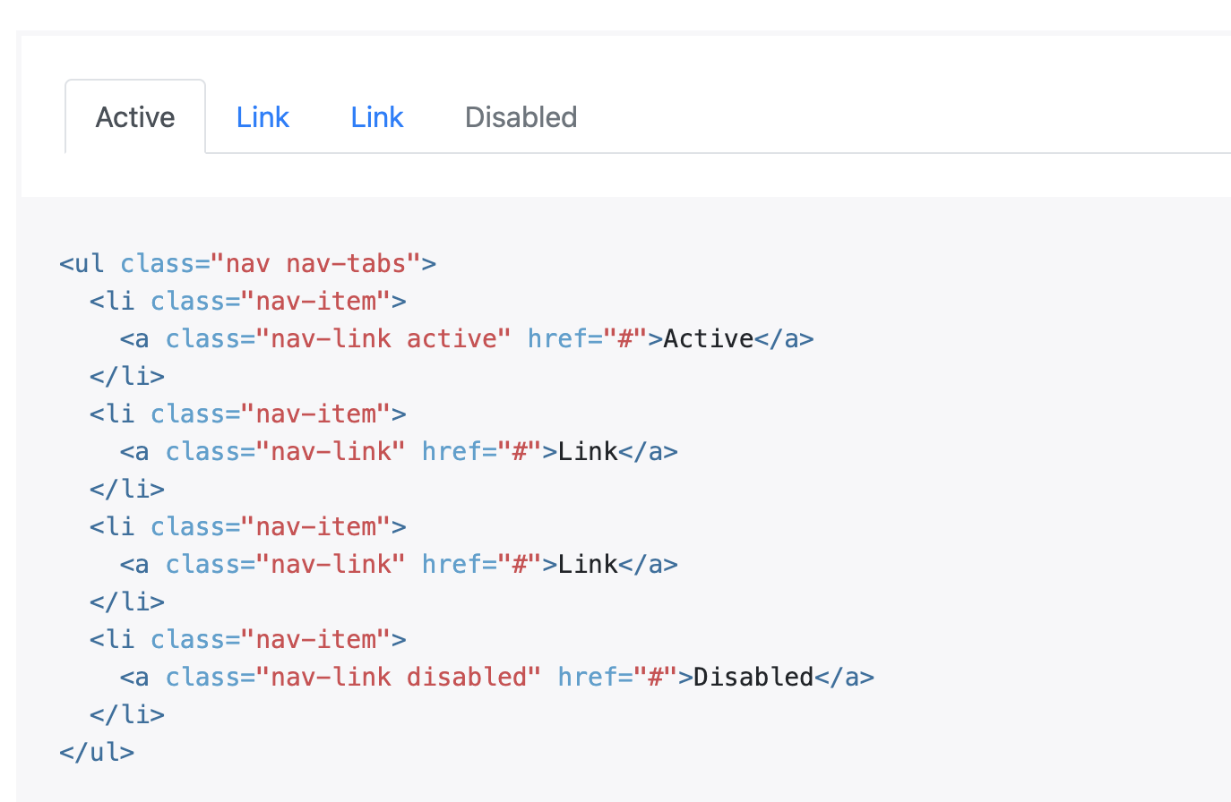
Bootstrap Tabs

Slide 23
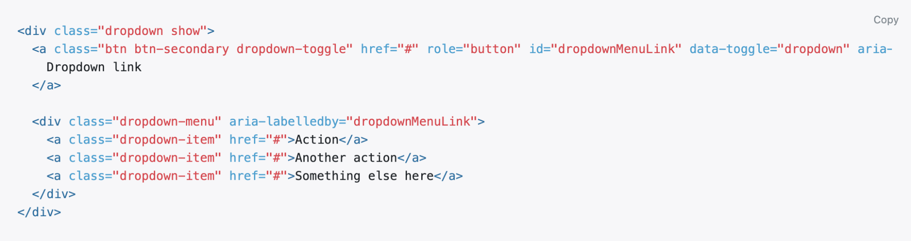
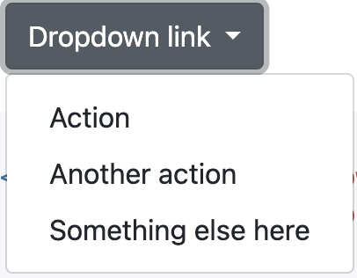
Bootstrap Dropdown Menu

Slide 24
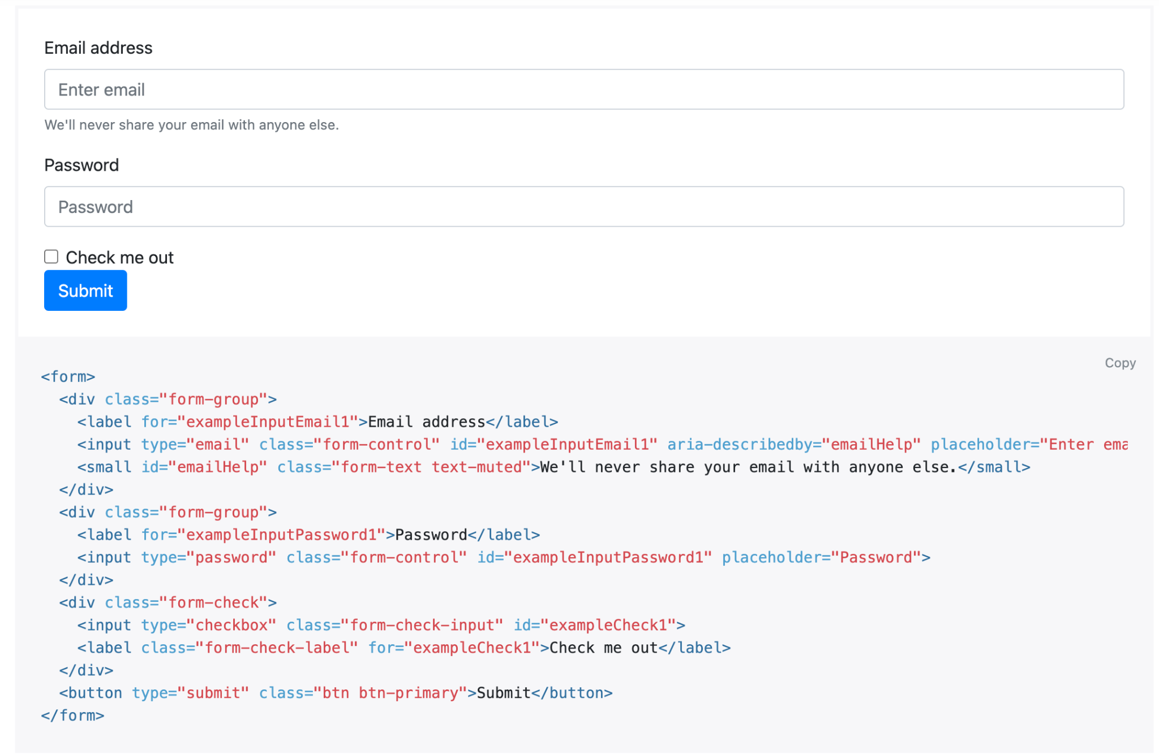
Bootstrap Form

Slide 25
Bootstrap Responsive
Breakpoints:
sm, md, lg, xl, xxl
Adapt layout based on screen size.
Mobile-First Approach:
Prioritize small screens and scale up.
Example:
<div class="col-sm-12 col-md-6 col-lg-4">Column 1</div>
<div class="col-sm-12 col-md-6 col-lg-4">Column 2</div>
<div class="col-sm-12 col-md-6 col-lg-4">Column 3</div>
<div class="col-sm-12 col-md-6 col-lg-4">Column 4</div>

Slide 26
Task
Create a responsive Bootstrap grid that displays

Slide 27
Resources to Learn
Slide 15: Resources to Learn More
Websites:
https://getbootstrap.com/docs/4.0/
Platforms:
FreeCodeCamp, Codecademy, or W3Schools.

